Slide 1
Recurrent Neural Network (Next-word Prediction)
Done By: Toh Kien Yu (P2222291)
Background Research:
Next-word prediction is a language modeling task in machine learning to predict the most likely word or a set of words that will come after a given input context.
This is widely used in real-life application such as the auto-complete feature on our smartphones, speech recognition system and more.
To sum it up, next-word prediction has accelerated our efficiency, accessibility and improved user experience.

Slide 2
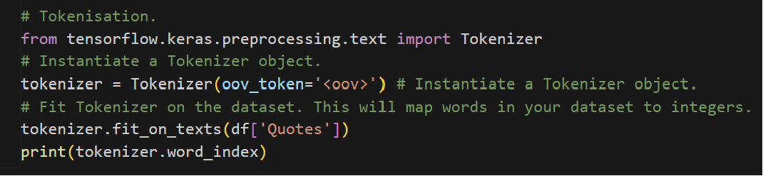
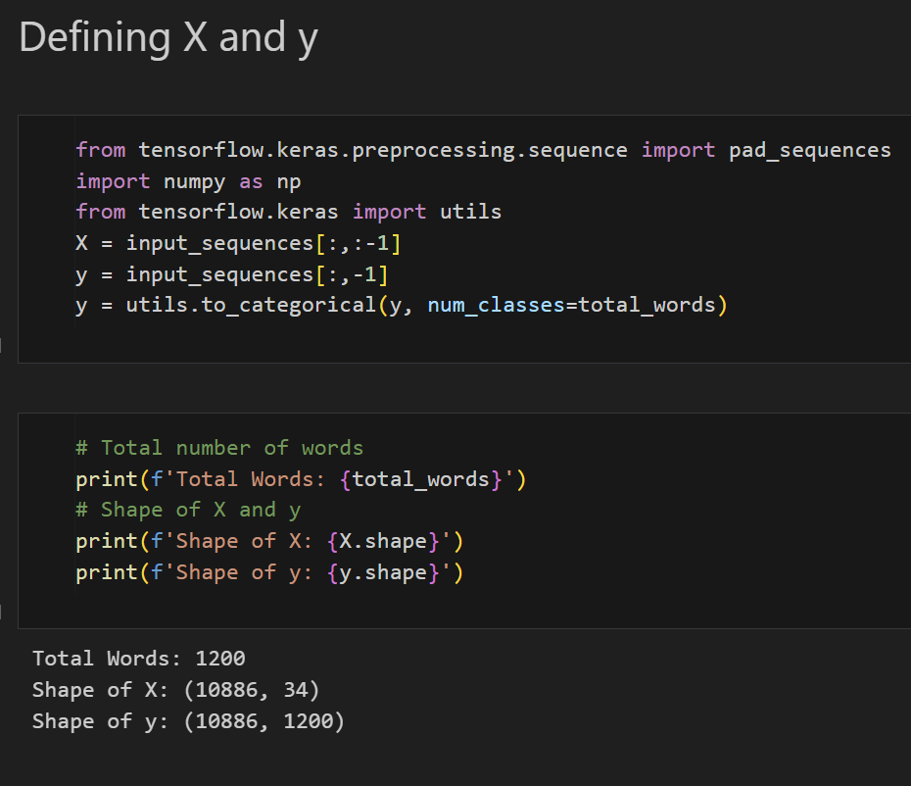
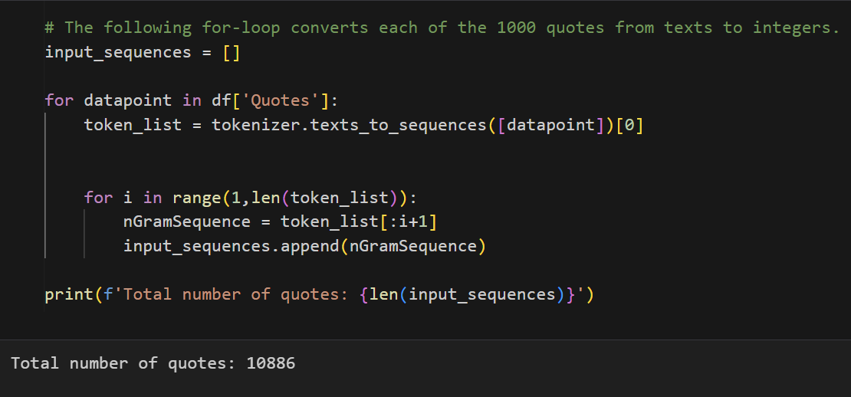
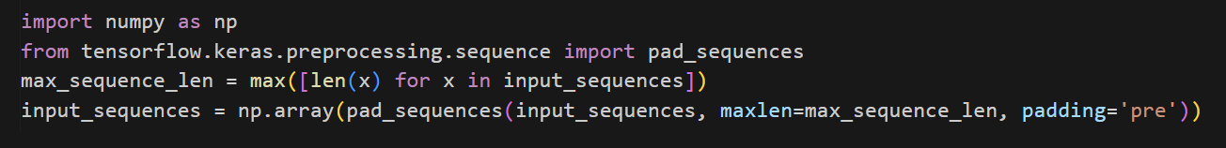
Data Preprocessing
Tokenize the dataset
Convert the quotes from text to integer

Slide 3
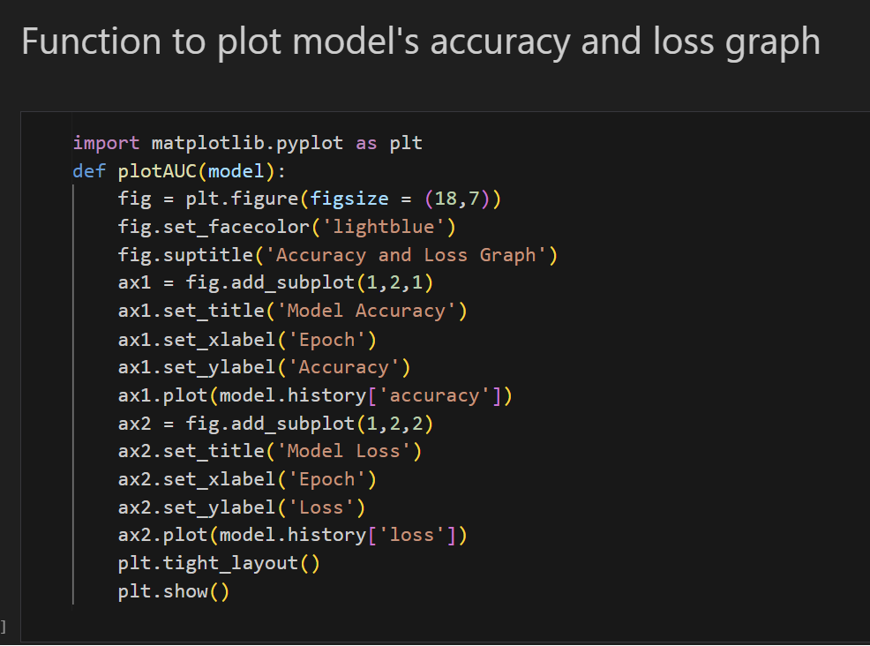
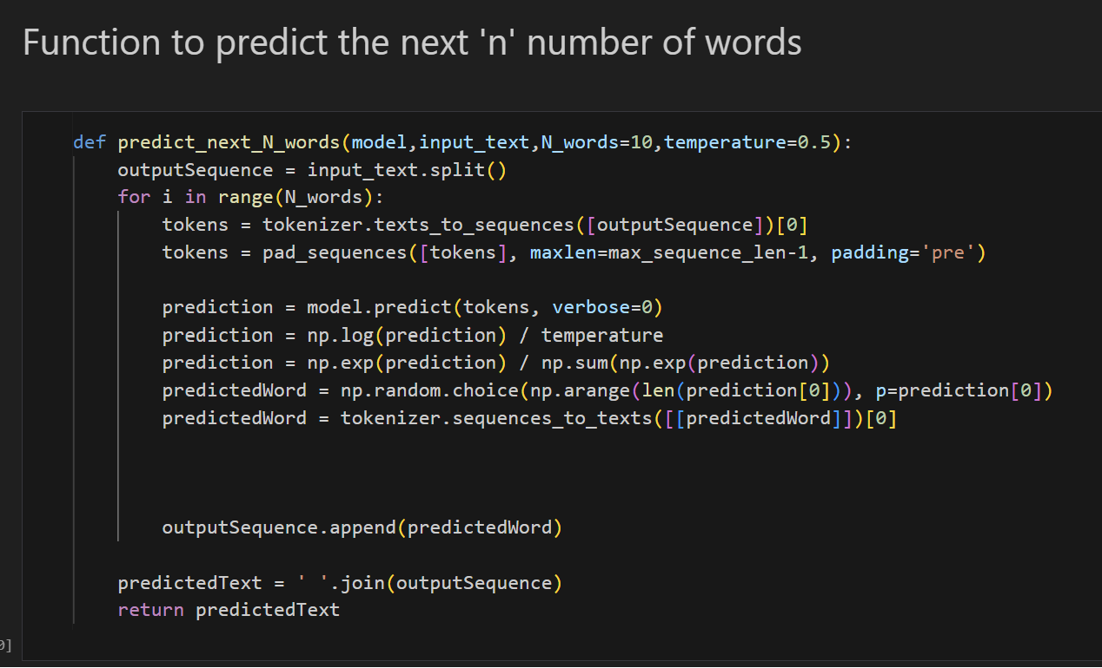
Utilities

Slide 4
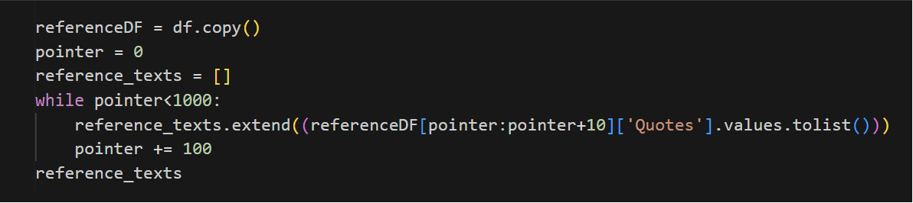
Evaluation
We will evaluate how meaningful the generated sequence of words, how creative they are using reference text.
Reference text was created by extracting the first 10 quotes from every set of 100 consecutive rows in the dataset.
Metrics:
BLEU Score (Bilingual Evaluation Understudy) measures the similarity of the machine's output text to a set of referenced translation
Jaccard Similarity is a measure of similarity between 2 sets
Human Evaluation involves obtaining input from human to assess the quality and creativity of the generated sequences.

Slide 5
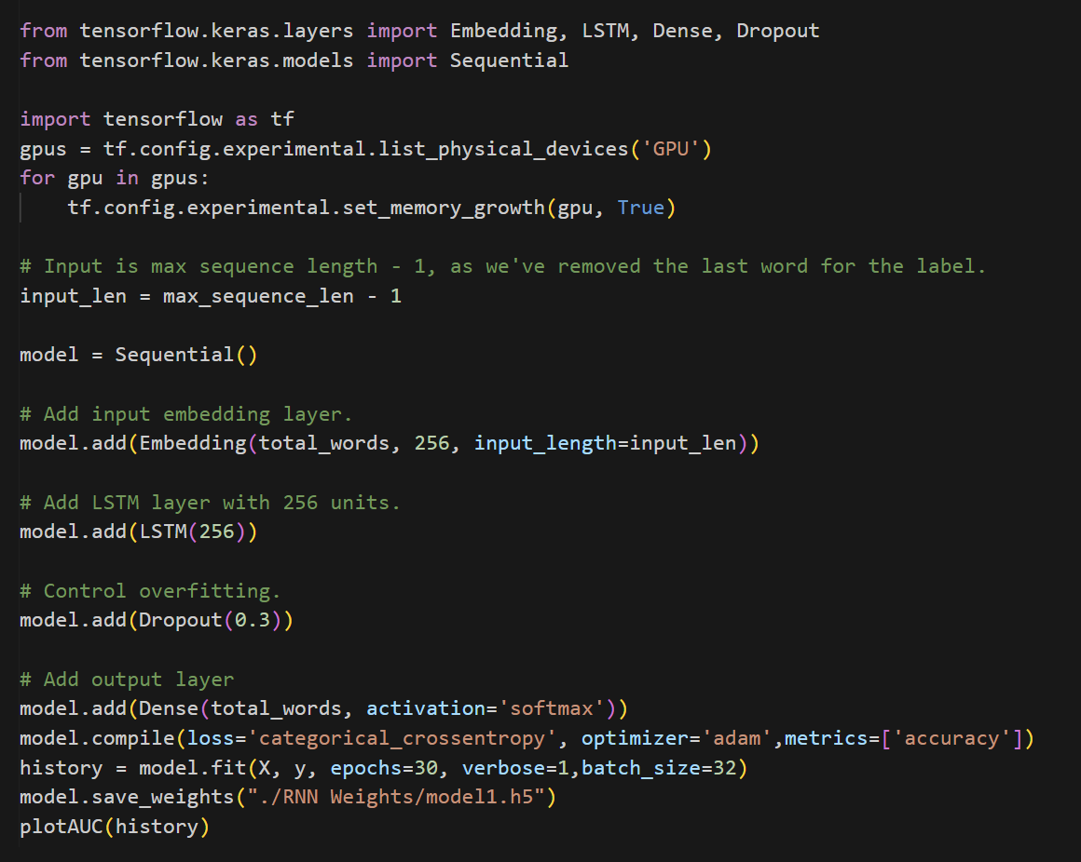
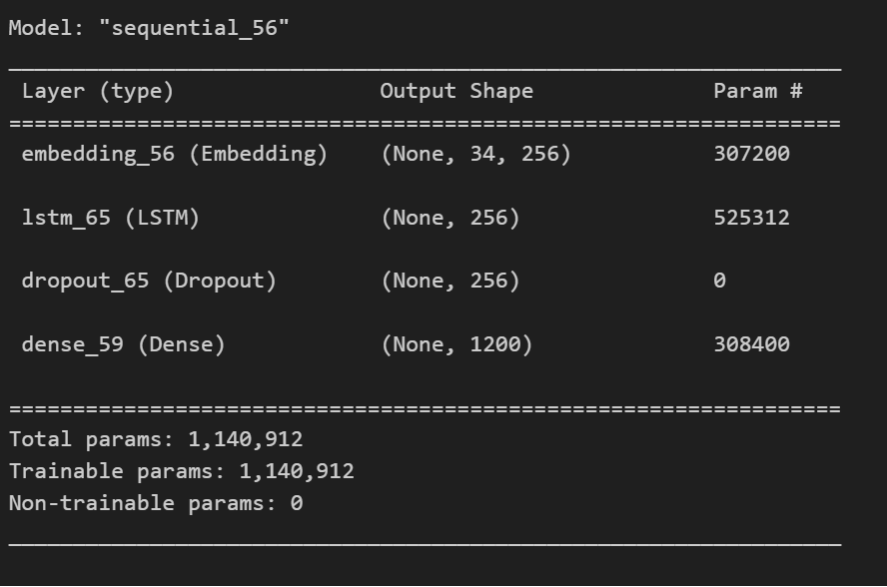
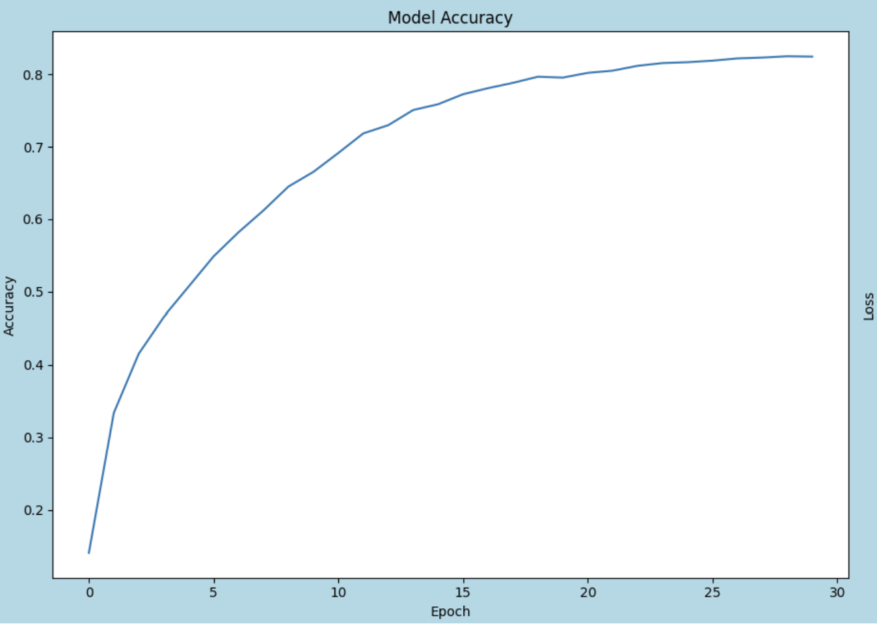
Model 1
Model 1 is designed to be a simple LSTM model, dropout was added to handle overfitting

Slide 6
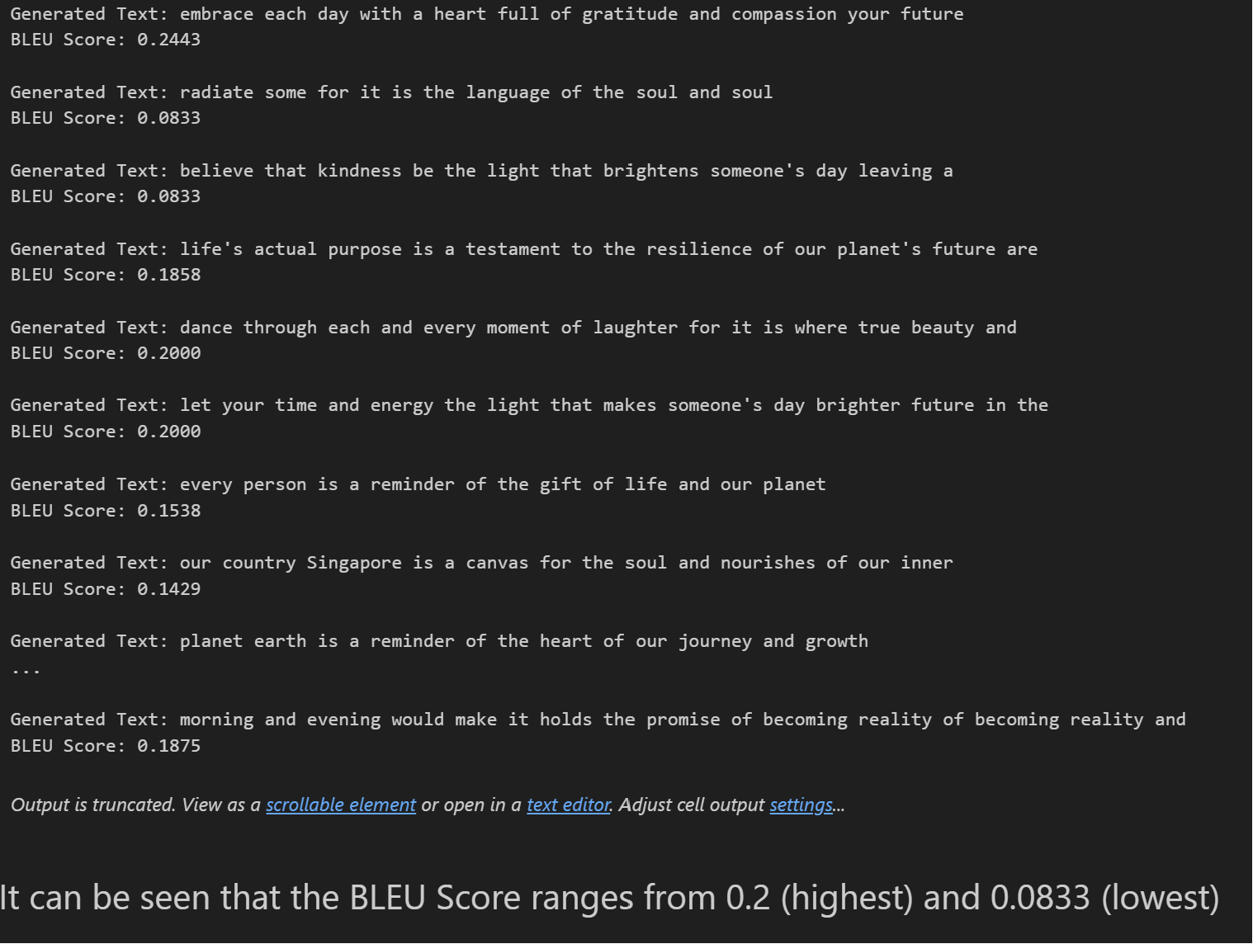
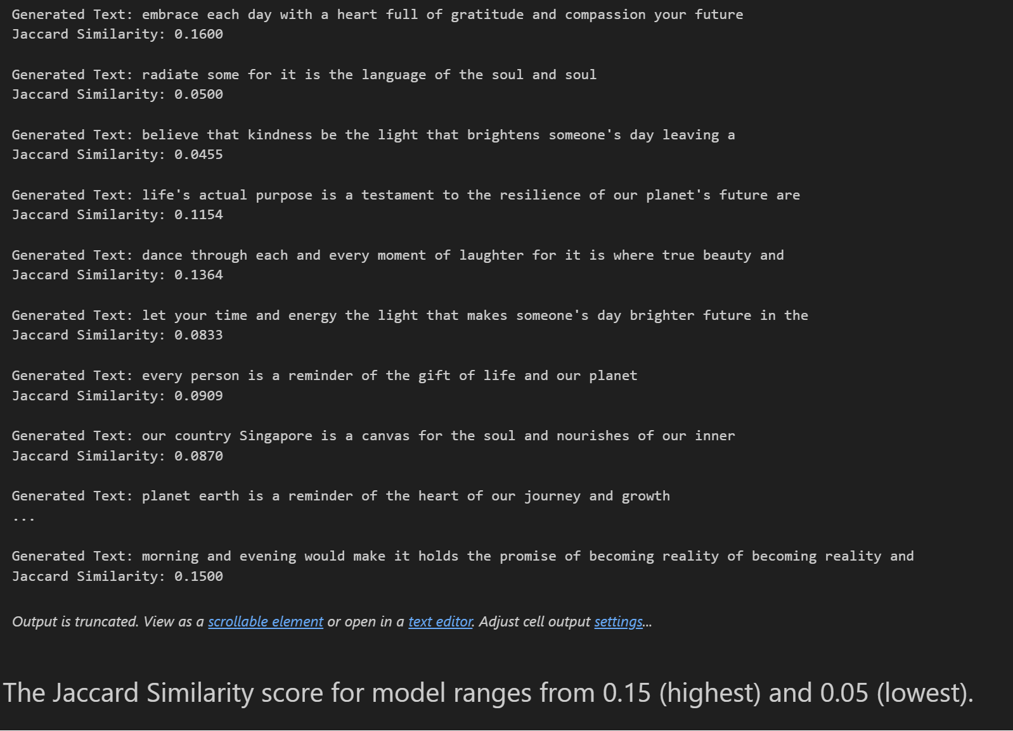
Model 1 Evaluation
BLEU Score
Jaccard Similarity

Slide 7
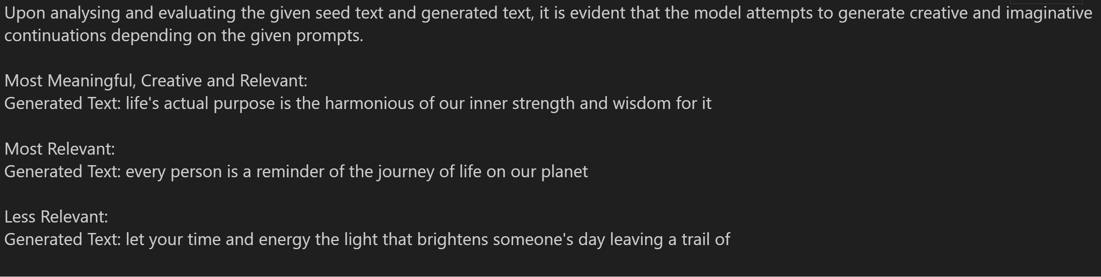
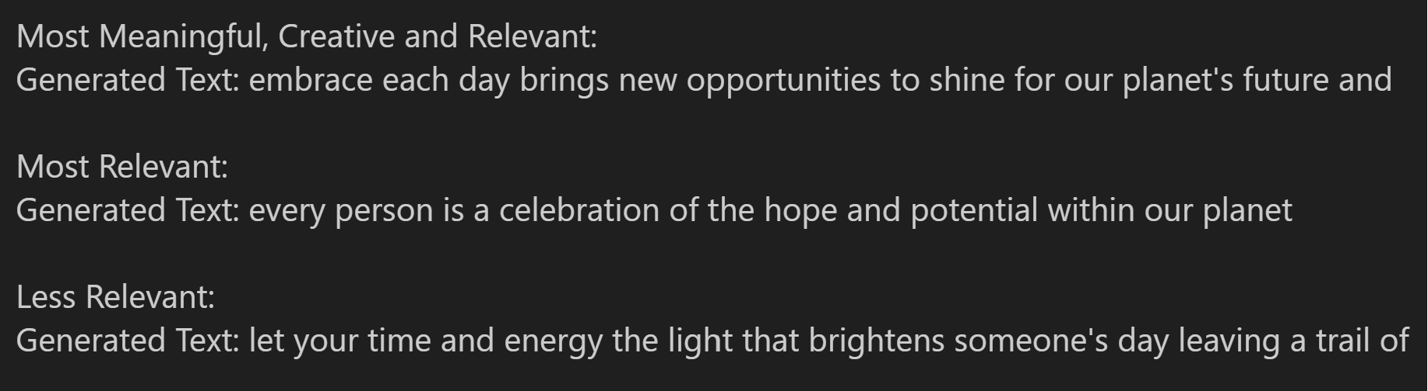
Model 1 Evaluation
Human Evaluation
I will be assessing the generated text based on the relevance, meaningfulness and creativity corresponding to the seed text. To achieve unique generated texts, I will use the model to generate the text twice.
First Run
Second Run

Slide 8
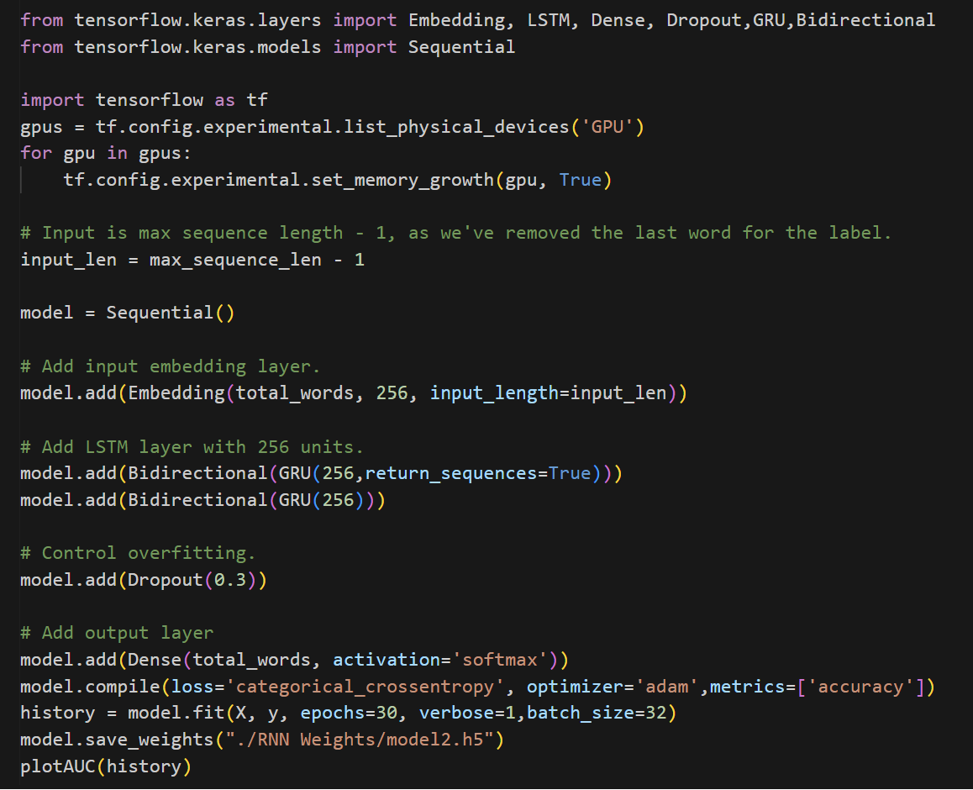
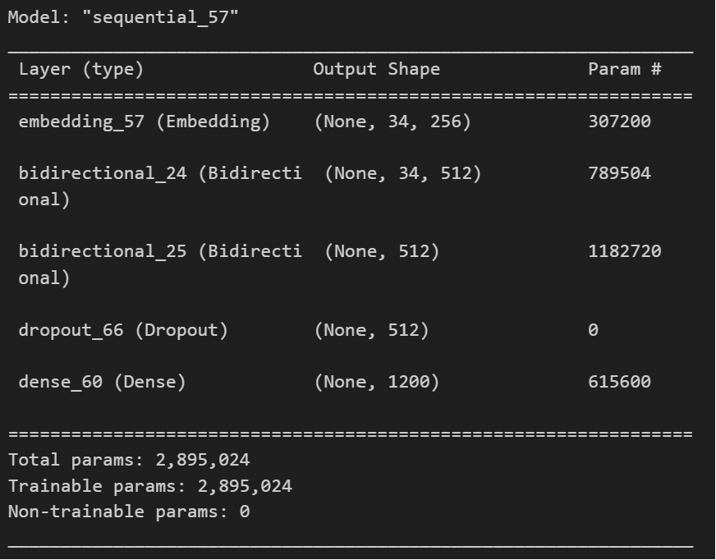
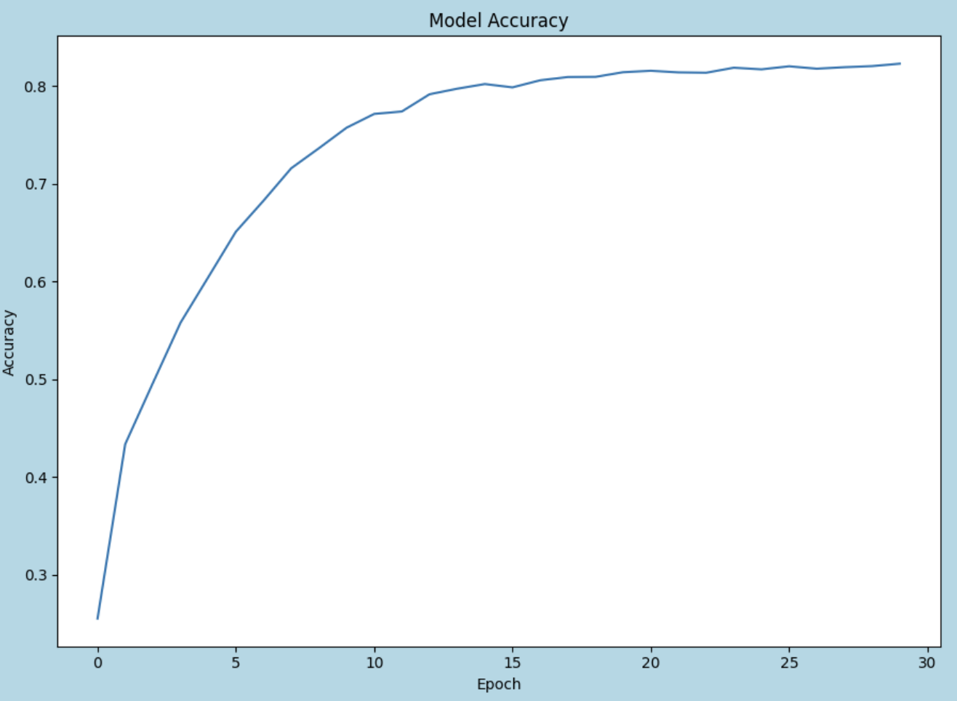
Model 2
For Model 2, I will experiment with GRU (Gated Recurrent Units).
Additionally, Bidirectional has been incorporated to enable the GRU to receive input from both forward and backward direction.

Slide 9
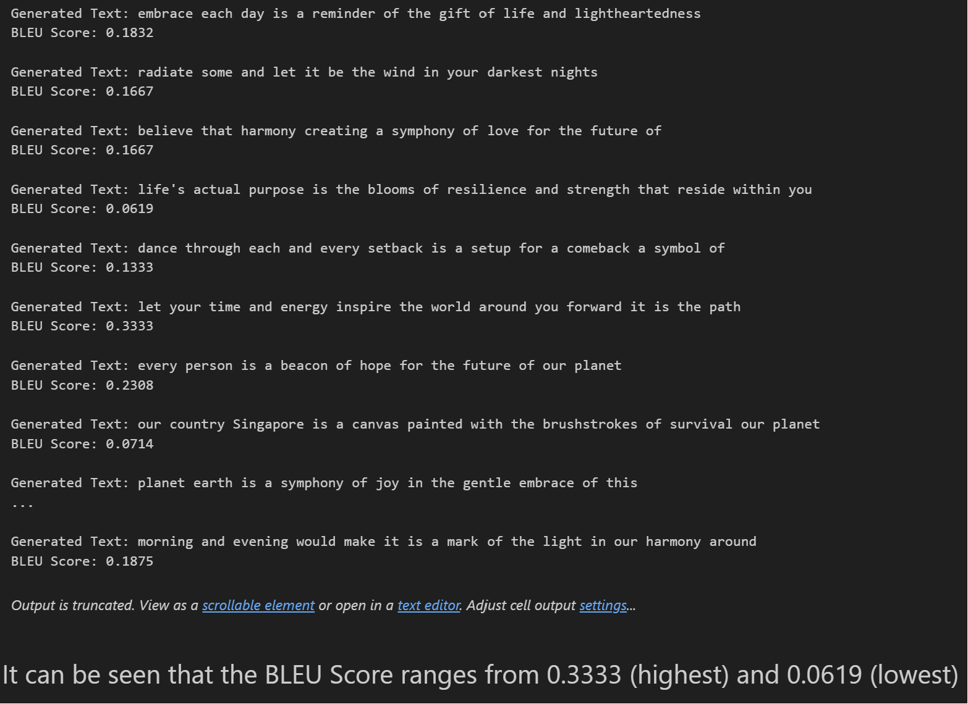
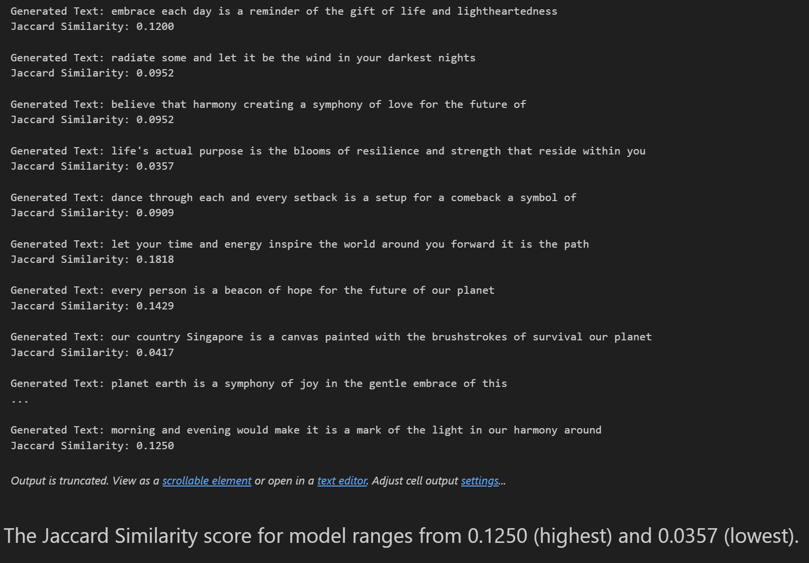
Model 2 Evaluation
BLEU Score
Jaccard Similarity

Slide 10
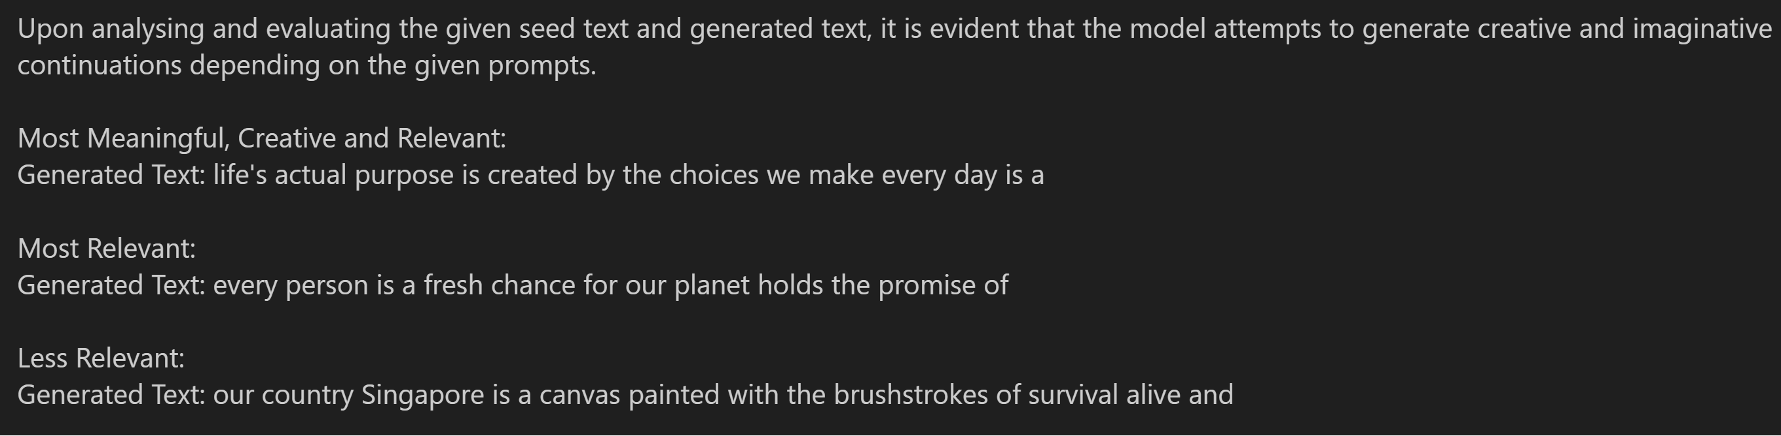
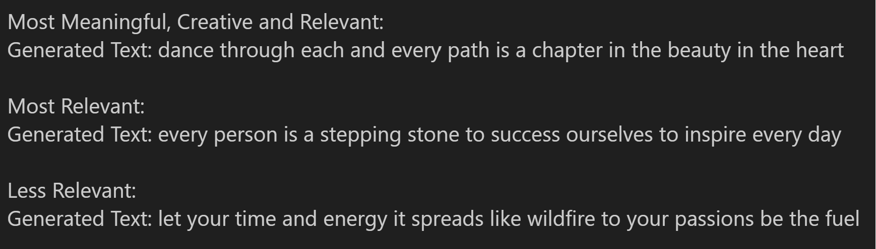
Model 2 Evaluation
First Run
Second Run

Slide 11
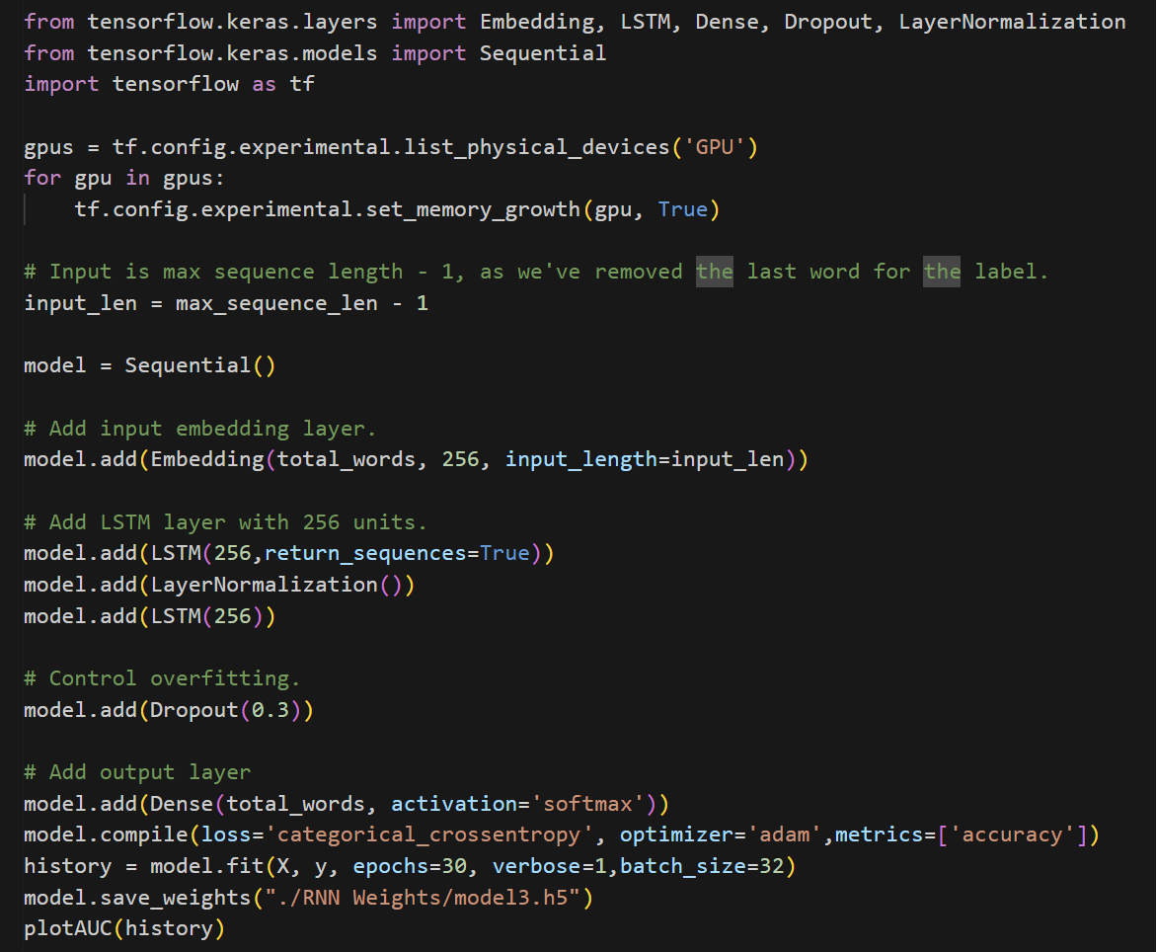
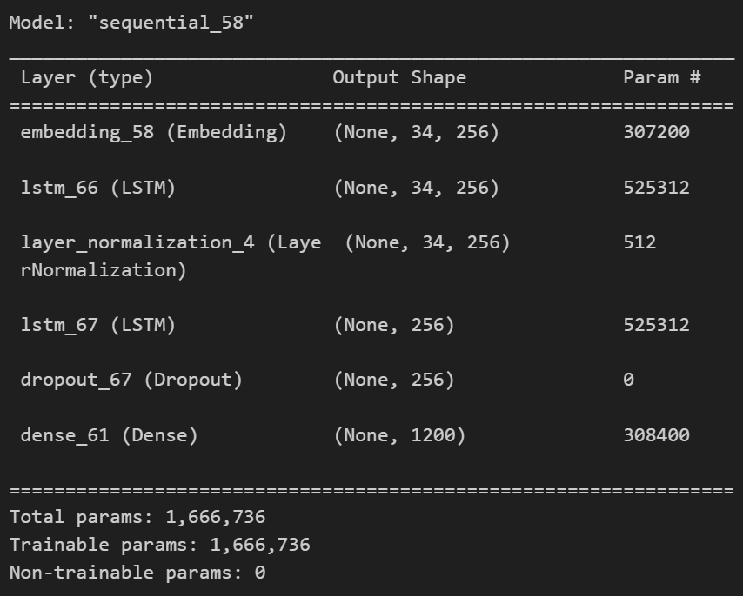
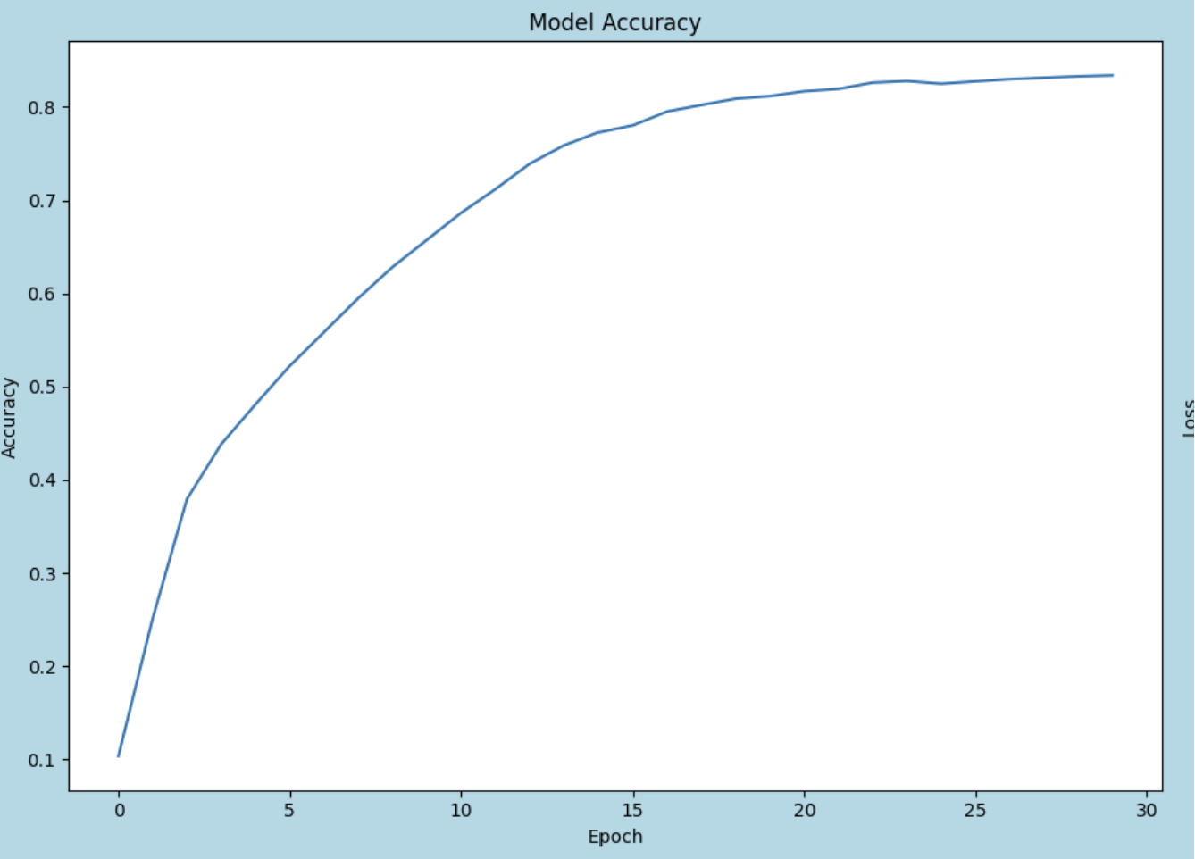
Model 3
For Model 3, I incorporated stacked LSTM and layer normalization.

Slide 12
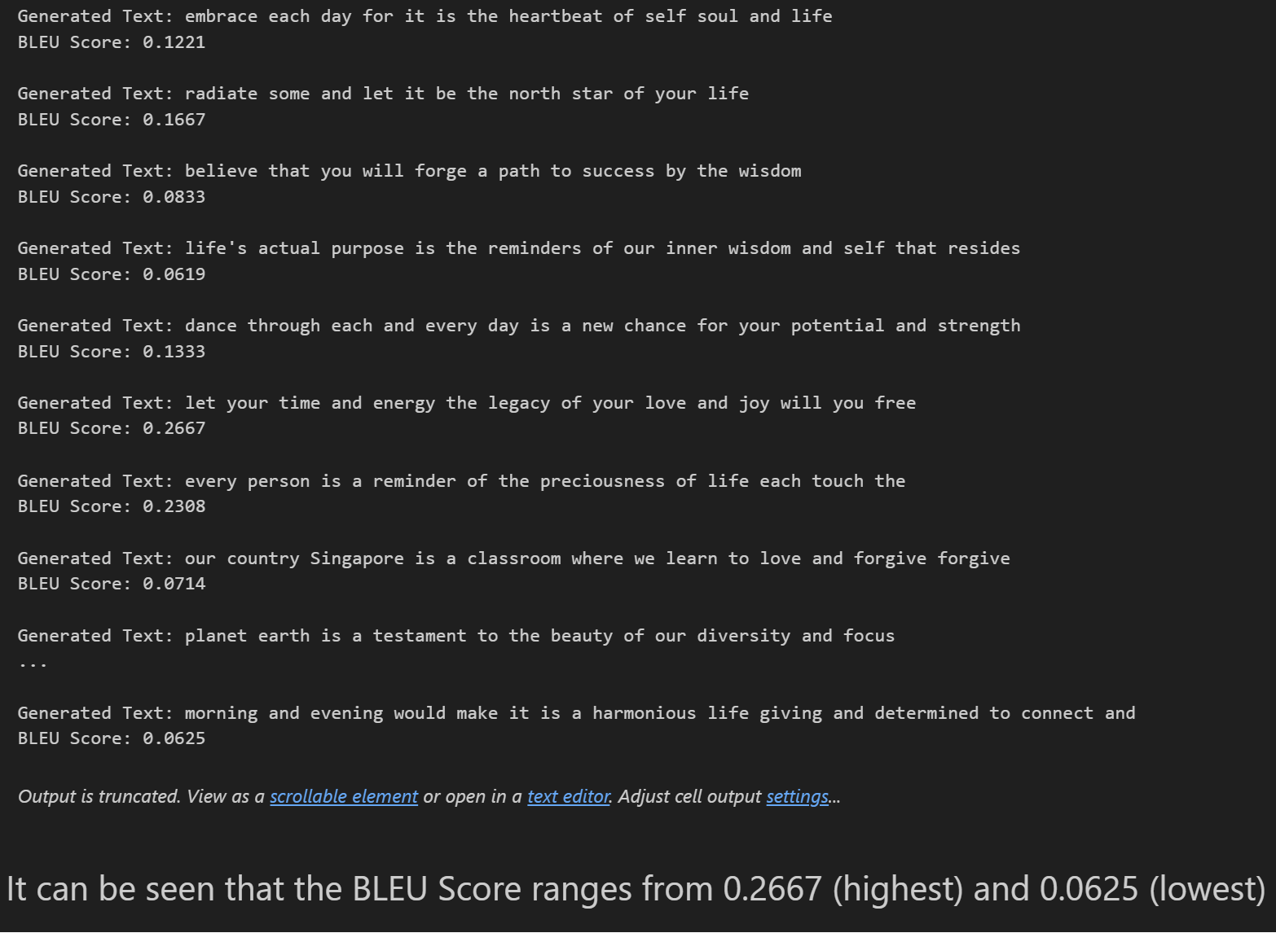
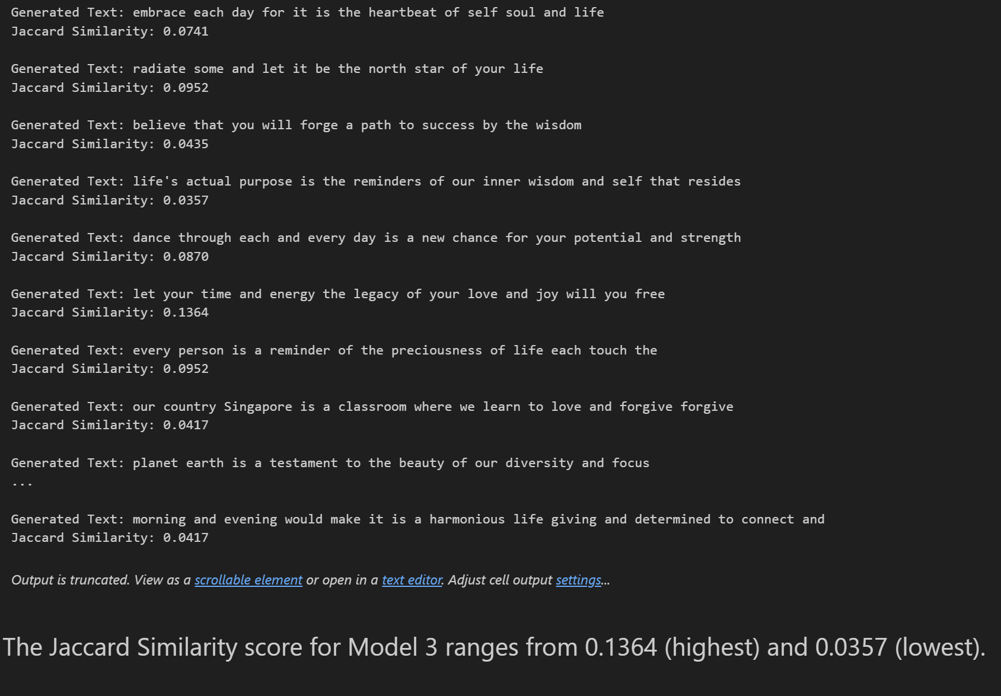
Model 3 Evaluation
BLEU Score
Jaccard Similarity

Slide 13
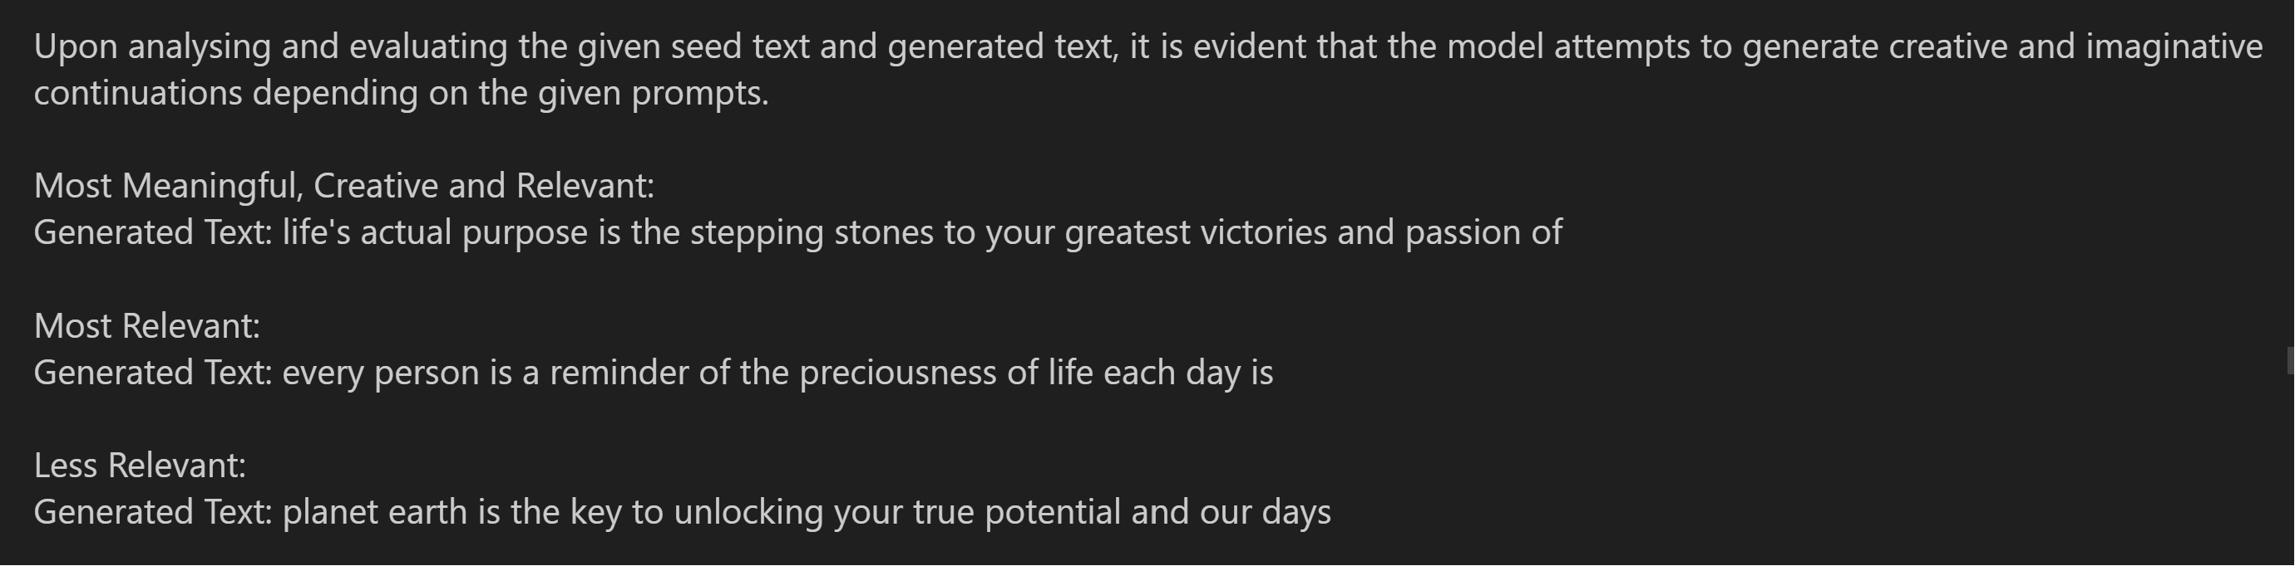
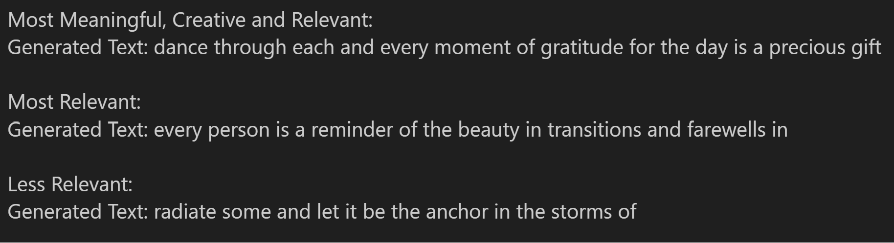
Model 3 Evaluation
First Run
Second Run

Slide 14
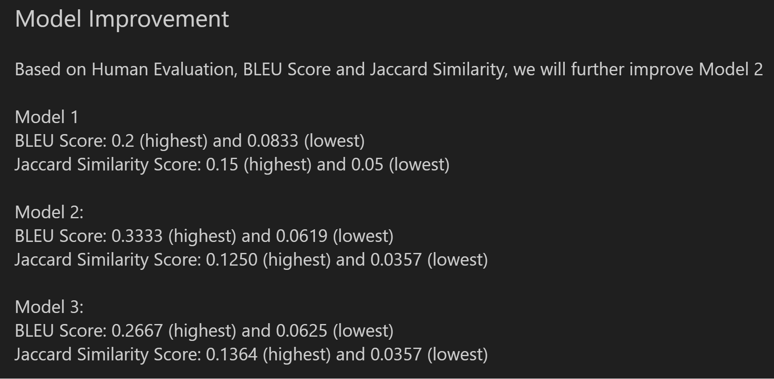
Model Improvement

Slide 15
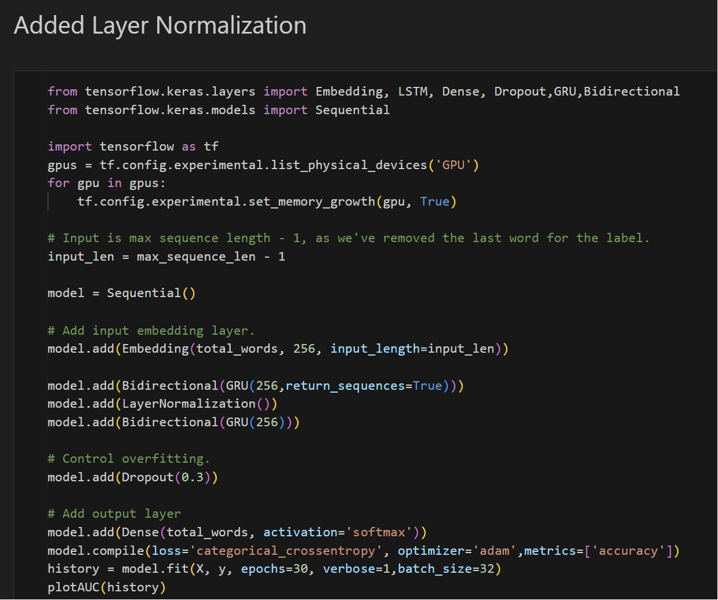
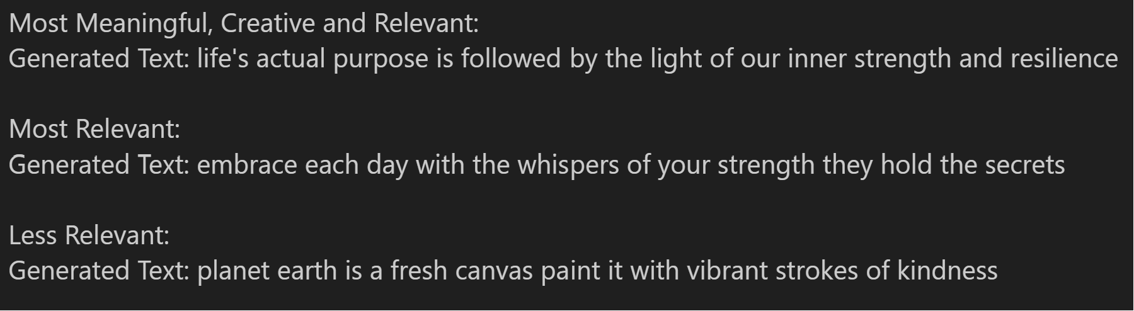
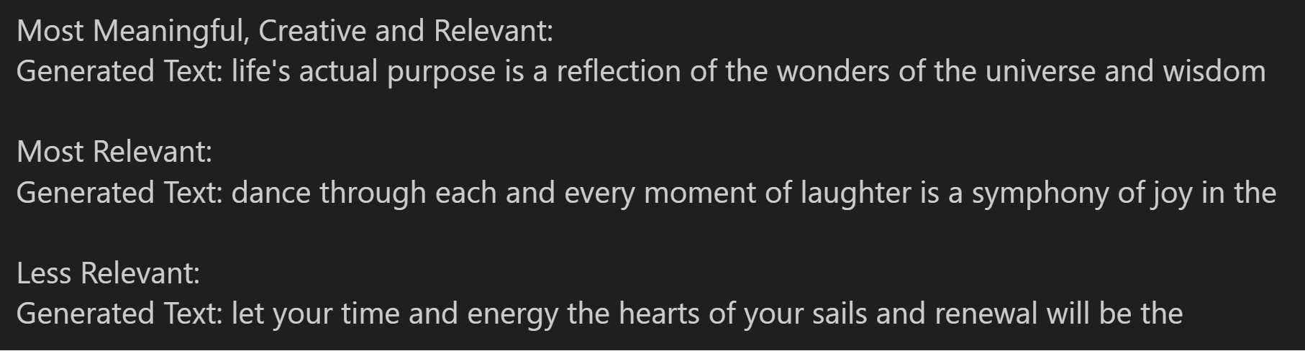
Model Improvement
We first assess if layer normalization improves our model
The BLEU score ranges from 0.25 (highest) and 0.0714 (lowest).
The Jaccard Similarity score ranges from 0.1364 (highest) and 0.0435 (lowest).
The Jaccard Similarity score increased upon adding layer normalization.
First Run
Second Run

Slide 16
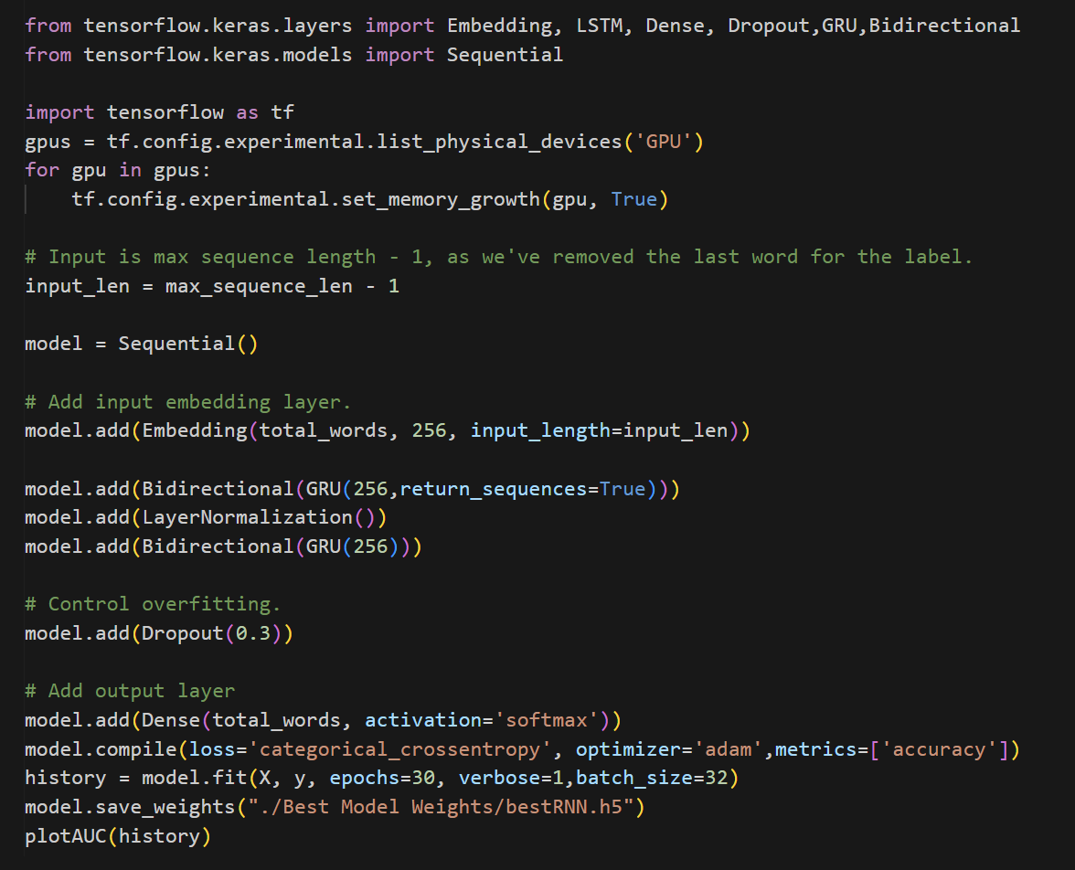
Final Model
My model has responded positively to the incorporation of Layer Normalization, hence we will add it into my final model.

